Slide 1
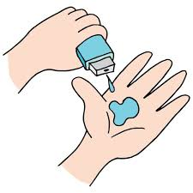
Project Title - Seasonal Agriculture Performance Analysis
Student Name : Aryan Rastogi ​
College Name : Amity University​
AICTE STU ID : (STU69611c333f6211767971891)

Slide 2

PROBLEM STATEMENT
Farming outcomes change drastically from season to season due to weather, water availability, and market rates.
Raw farm records don't easily show why some seasons fail while others thrive.
Our Goal: Analyze 4,000 farm records across Kharif, Rabi, and Zaid to find clear patterns in crop yield, water use, and farmer profits, helping farmers and planners make smarter decisions.

Slide 3
Project Description [An end-to-end data analytics and visualization study conducted on a multi-regional agricultural dataset (4,000 records, 28 attributes) spanning environmental, agronomic, resource, and financial dimensions. • Data Preprocessing & Cleaning: - Addressed missing values in Rainfall (48 rows), Soil Moisture (40 rows), and Yield (32 rows) using median and seasonal crop-wise imputation. - Standardized feature formats and engineered key analytical indicators: Yield per Hectare, Water Efficiency Ratio, and Net Profit Margins. • Core Analytical Dimensions: 1. Seasonal Productivity: Comparative evaluation of crop yields across Kharif, Rabi, and Zaid. 2. Environmental Interaction: Correlation analysis of rainfall, temperature, sunlight, and humidity against agricultural output. 3. Resource Optimization: Benchmarking water consumption (m³) and fertilizer dosage across irrigation techniques (Drip, Sprinkler, Flood, Rainfed). 4. Economic Profitability: Cross-seasonal revenue vs. cost analysis identifying profitability thresholds. ]

Slide 4

WHO ARE THE END USERS?
1. Farmers & Farmer Producer Organizations (FPOs): - Access seasonal crop suitability insights and optimal sowing schedules. - Adopt precision irrigation and balanced fertilization to maximize net margin.
2. Agricultural Extension Officers & Agronomists: - Provide localized advisory services backed by empirical yield benchmarks. - Detect early disease and pest susceptibility patterns tied to humidity and rainfall.
3. Policymakers & Government Agriculture Departments: - Formulate targeted seasonal subsidy schemes (e.g., micro-irrigation incentives for Zaid). - Design evidence-driven minimum support price (MSP) interventions and drought relief programs.
4. Agri-Input Suppliers & Supply Chain Managers: - Accurately forecast seasonal demand for fertilizers, drip equipment, and pesticides. - Plan storage, logistics, and cold chain capacity aligned with seasonal harvest surges.

Slide 5

Technology Used
Environment: VS Code and Google Colab for writing and testing python code.
Python Libraries:
Pandas & NumPy: For loading the dataset, fixing missing data, and calculating averages.
Matplotlib & Seaborn: For building clean charts, heatmaps, and comparisons.
Version Control: Git and GitHub for saving code and project tracking.

Slide 6
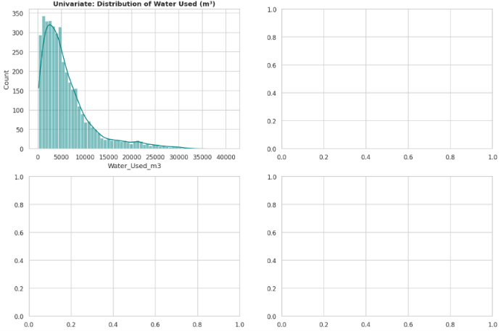
RESULTS

Slide 7
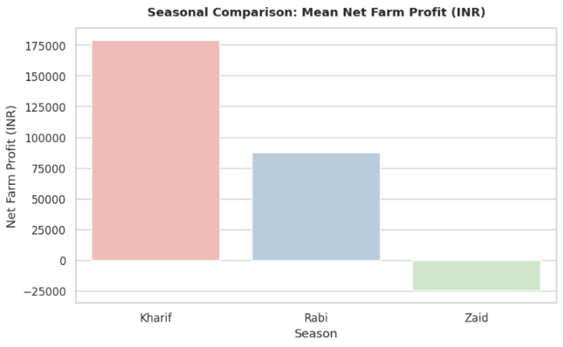
RESULTS

Slide 8
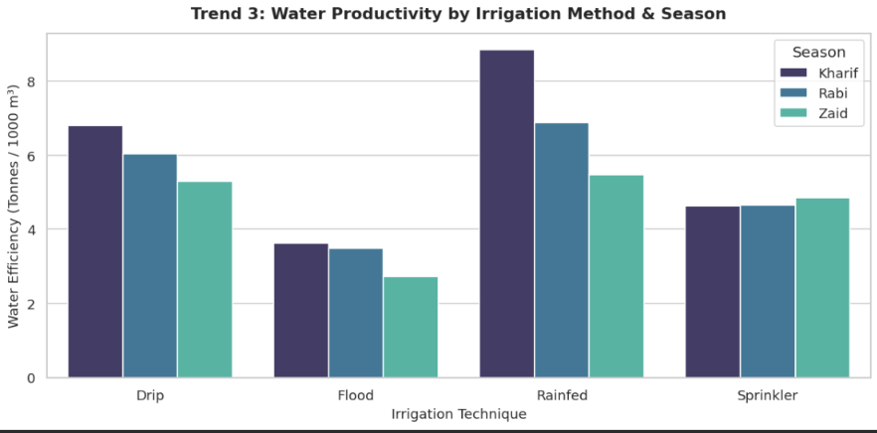
RESULTS

Slide 9
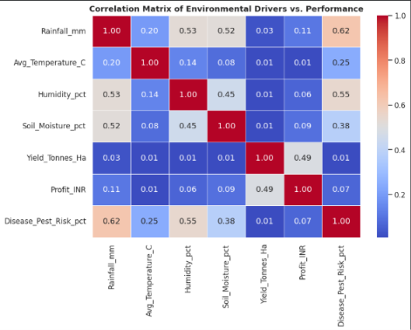
RESULTS
[Add screen shots of your code ]

Slide 10
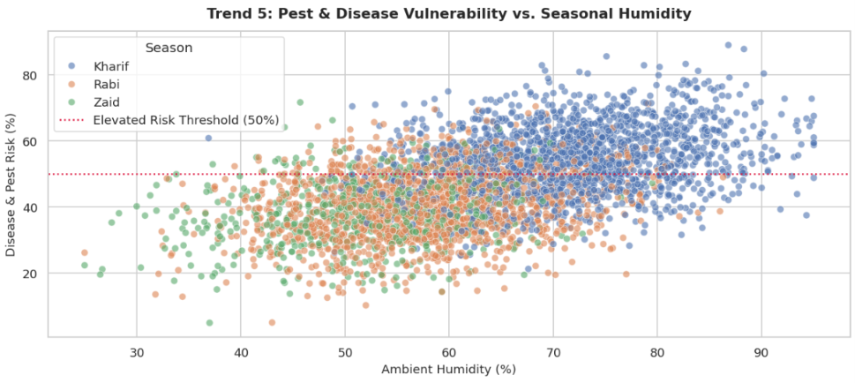
RESULTS
[Add screen shots of your code ]

Slide 11
Future scope Yield Prediction: Train machine learning models (like Random Forest) to predict harvest yield and profit before seeds are sown.
IoT & Satellite Monitoring: Connect live ground moisture sensors and satellite maps to give farmers live soil updates.
Advisory Tool: Create an automatic recommendation alert to suggest drought-resistant crops if bad weather is forecast.
Farmer Web App: Build a simple web dashboard (using Streamlit) where farmers can enter their costs and see expected returns.

Slide 12
GitHub Link https://github.com/aryanrastogi265-bot?tab=repositories

Slide 13

VOIS Course completion certificate - Course name- Data Visualization

Slide 14
Thank you
Aryan Rastogi
Amity University
.
.

